Slide 1

THE SPARKS FOUNDATION
GRIP JULY 2021
TASK 3 : Payment Gateway integration
By,
Narapureddy Harinath Reddy
Web Development and Designing
Intern

Slide 2
Create a simple website where payment gateway is integrated.
There will be a simple donate button on homepage. On clicking the donate button, the user will land on the payment page where user can select the amount to be paid and the payment type, e.g. credit card, Paypal, etc.
Once the payment is done and invoice will be generated and email will be sent to the user for the payment received. The invoice will contain the amount.
On any page / email, only basic information is needed.
Hosted the website at 000webhost,

Slide 3
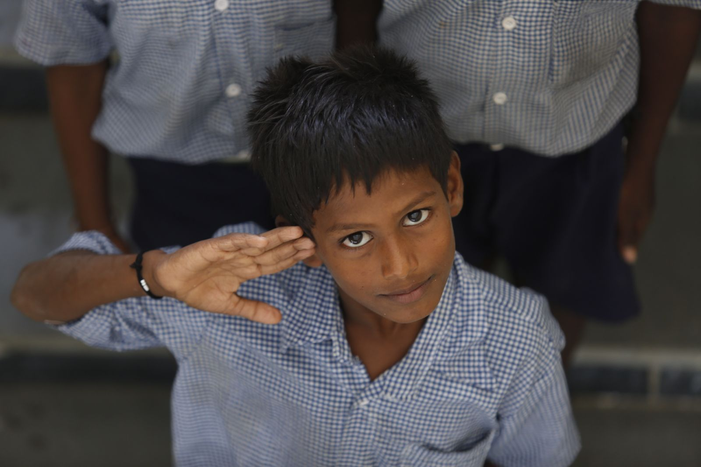
AKSHAYA PATRA
Donate for Food and Education…
DONATE FRESHLY COOKED MEALS WITH YOUR SUPPORT:
There are over 40 million widowed women in India. That means that 10% of the female population are living without their husbands.
Many of them are abandoned by their families and children, hunger is the immediate issue that needs to be addressed. A moderately active woman should consume 1,800-2,200 calories a day. Hot, fresh, nutritious and hygienic meals help them survive and ward off diseases that come their way.
Vision
NO CHILD IN INDIA SHALL BE DEPRIVED OF EDUCATION BECAUSE OF HUNGER.
Mission
TO FEED 5 MILLION CHILDREN BY 2025.

Slide 4
THANK YOU

